Slide 1


Hamro Yatra
School of Environmental Science and Management
Faculty of Science and Technology
Pokhara University, Nepal
May 2025

Slide 2

A Project Proposal: Hamro Yatra
This project proposes a web-based platform for easy travel package booking.

Slide 3

Introduction to Hamro Yatra
Tourism Growth
Travelers increasingly prefer online booking over traditional methods.
Current Issues
Difficulty comparing packages, availability, and secure booking.
Our Solution
Centralized app easing search, booking, and management for tours.
User Benefits
Supports both tourists and operators with seamless experience.

Slide 4

Background and Problem Statement
Current Challenges
Agency Issues
Travelers face scattered info, booking delays, and lack of transparency.
Manual booking management causes inefficiency and errors.
Project Goal
Create a centralized, user-friendly web app for tourists and admins.

Slide 5
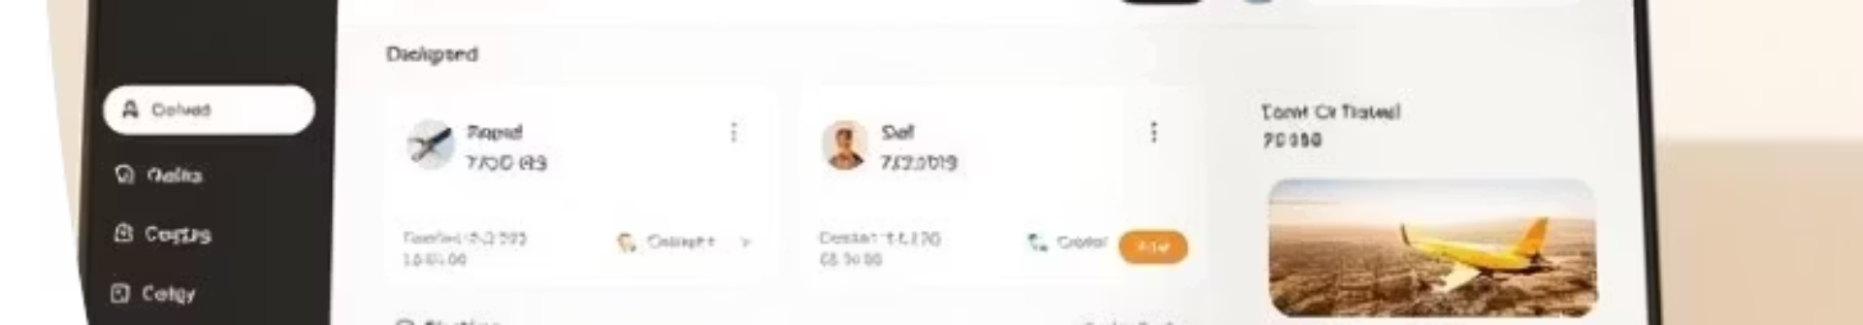
Project Objectives
Tourist Convenience
Real-Time Booking
Search and book based on destination, budget, and duration.
Instant confirmation with updated availability.
Admin Control
Security & Usability
Manage packages, bookings, and users through a dashboard.
Secure login and responsive, easy-to-use interface.

Slide 6
System Requirements
Functional
Non-Functional
Browse, search, and book packages
Scalable and secure architecture
Admin package/booking management
24/7 availability
Secure user and admin login
Cross-device support
User-friendly and fast interface

Slide 7
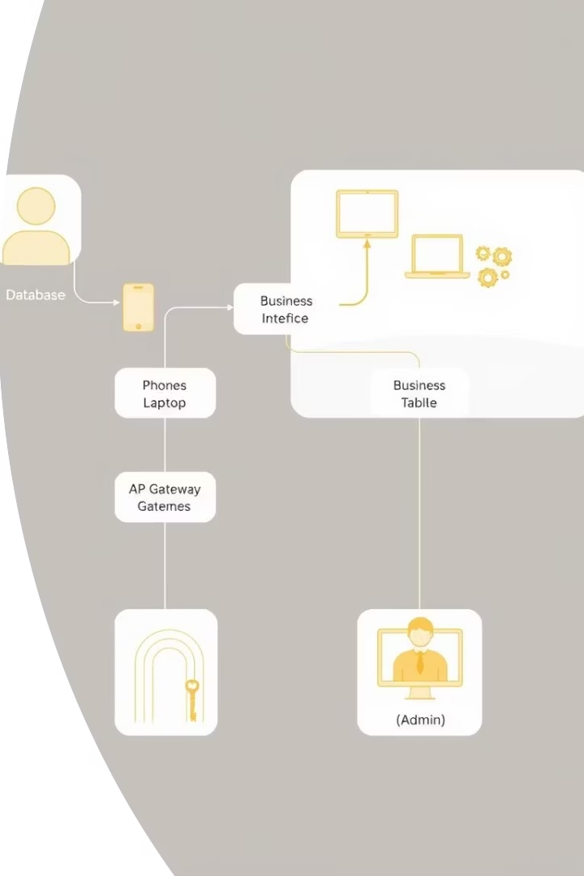
Design and Architecture
Modular Design
Independent components working seamlessly together.
Database Structure
Entities: User, Admin, Store, Location, Booking, Routes.
User Interaction
Flow from login through booking confirmation with error handling.

Slide 8
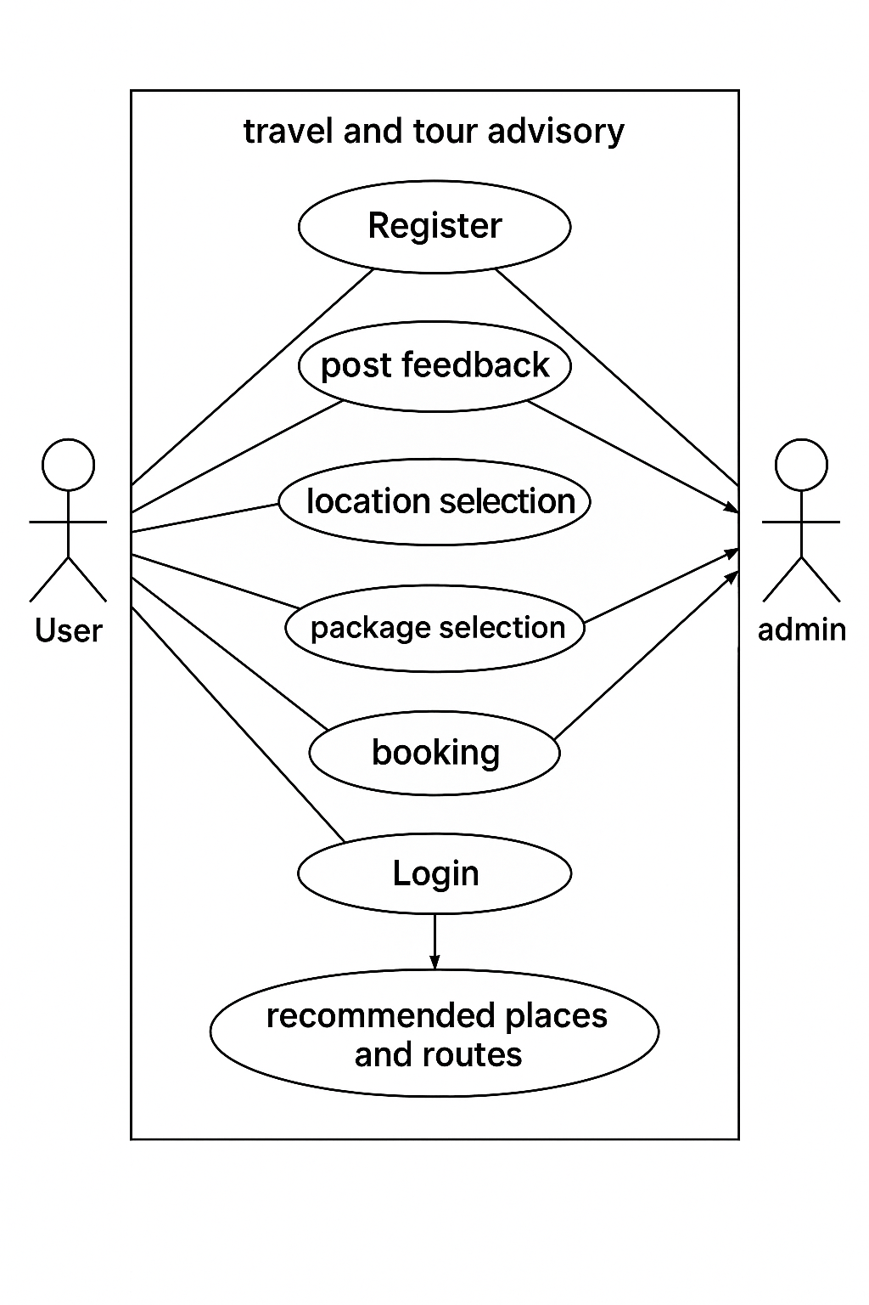
Use case diagram
It shows interactions between the User and Admin. Key functions include:
User Actions: Registration, posting feedback, selecting locations, choosing packages, booking, and logging in.
Admin Role: Managing user interactions and providing recommendations for places and routes.

Slide 9
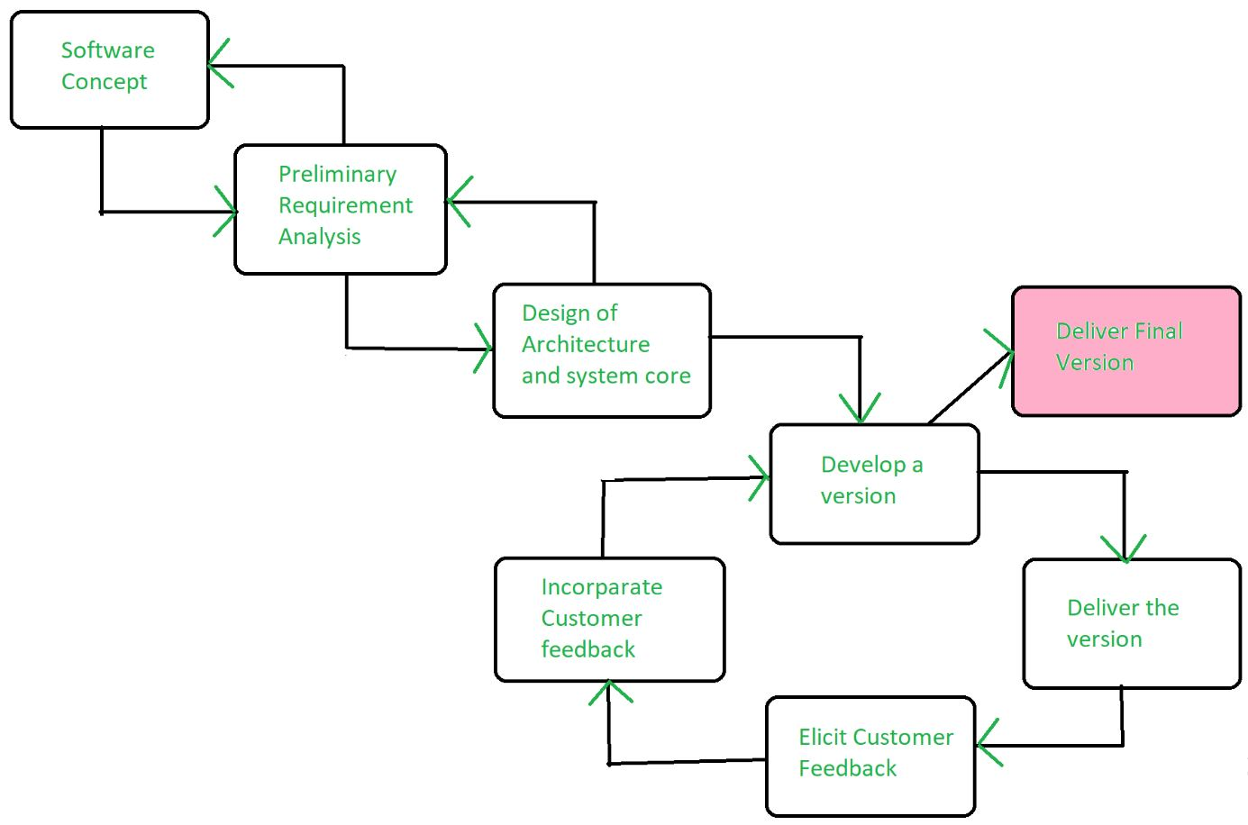
Model : Evolutionary Model
We are using evolutionary model, which emphasizes incremental improvement, user feedback, and ongoing adaptation, our project represents a shared journey of progress. The name symbolizes growth, flexibility, and teamwork

Slide 10
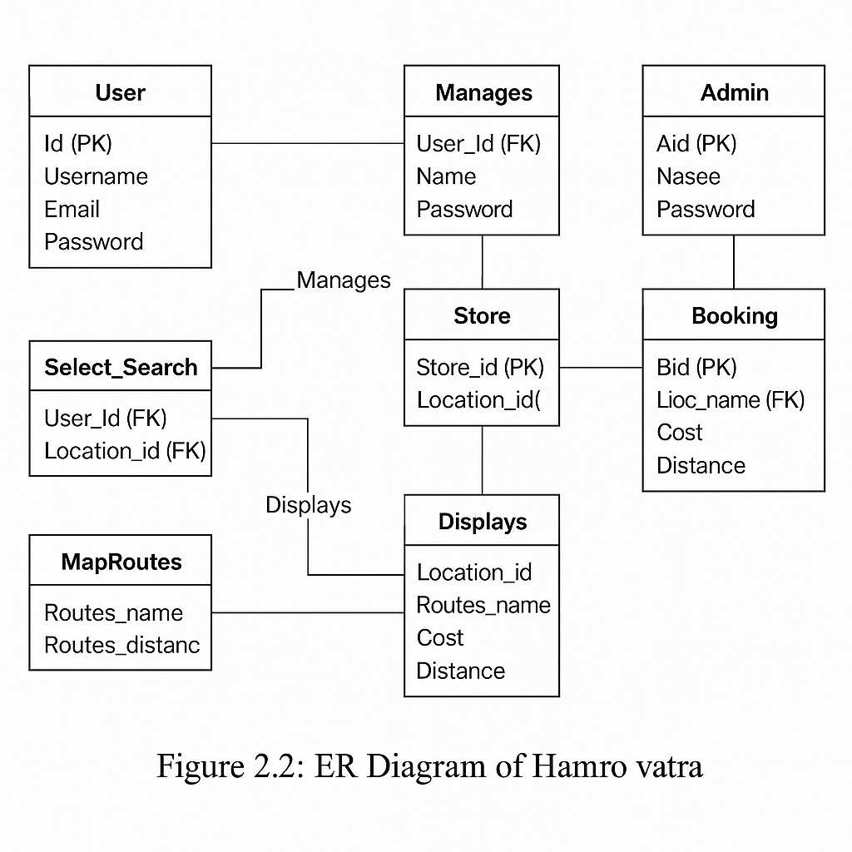
Entity Relationships Overview
Relationships:
User and Select_Search: A user searches or selects locations via the Select_Search entity.
User and Manages: Users are managed by admins through the Manages entity.
Admin and Manages: Admins manage users via the Manages entity.
Store and Booking: Stores are linked to bookings, where users make a reservation.
Store and Displays: Locations displayed are tied to stores via the Displays entity.
MapRoutes and Displays: Routes are displayed for certain locations through Displays.
MapRoutes and Store:
Routes are associated with stores in a certain location.

Slide 11
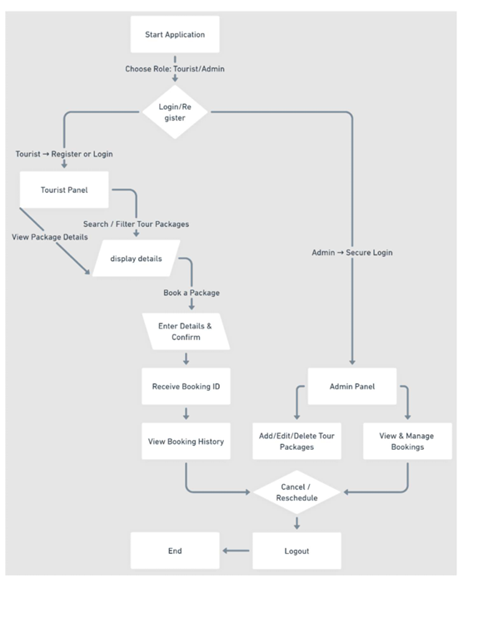
Application Flow Summary
Tourist Flow
Login/Register
Search and view packages
Book and get Booking ID
View history and manage bookings
Logout
Admin Flow
Secure login
Manage packages and bookings
Handle cancellations and rescheduling
Logout

Slide 12
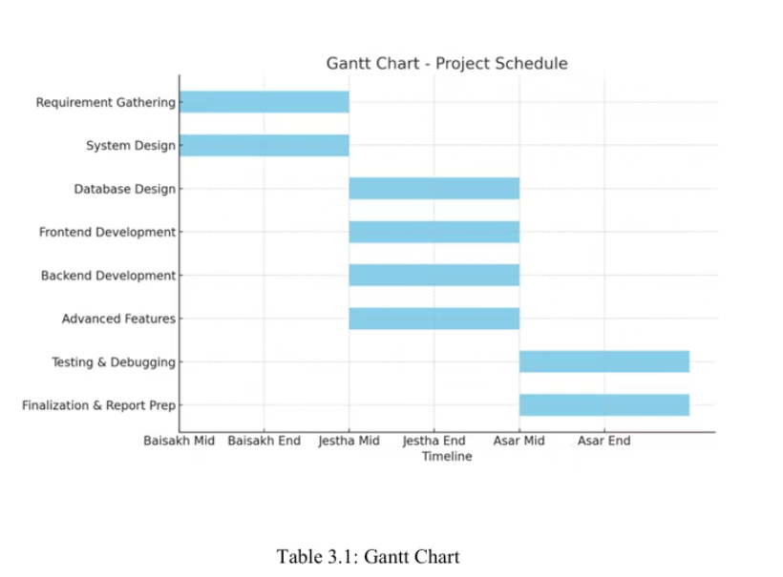
Gantt Chart Overview – Project Timeline
Timeline Phases & Activities
Baisakh Mid to Jestha Mid
Requirement Gathering
System Design
Jestha Mid to Asar Mid
Database Design
Frontend Development
Backend Development
Advanced Features
Asar Mid to Asar End
Testing & Debugging
Finalization & Report Preparation

Slide 13
Expected Outcomes
User Experience
Admin Efficiency
Scalability
Streamlined, secure, and real-time booking platform enhances satisfaction.
Centralized management reduces errors and administrative workload.
Modular design supports future growth and easy maintenance.

Slide 14
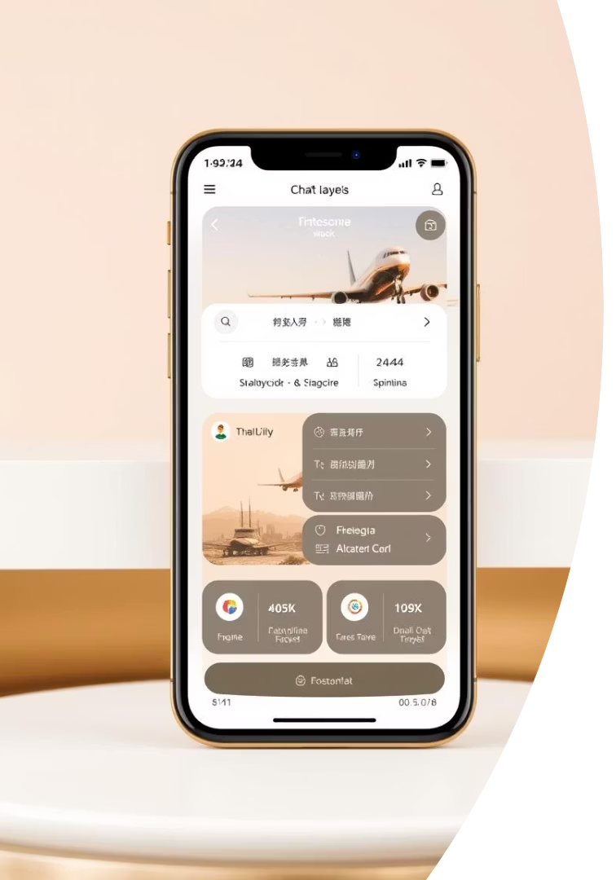
Future Enhancements
Payment Gateway
Integrate secure online payment options.like Esewa,Khalti,connect ips
Mobile App
Enable booking via smartphones.
Personalized Recommendations
Suggest packages based on user preferences.
Multilingual Support & Chatbot
Expand accessibility and real-time customer help.

Slide 15


